Slide 1
Topic 1 Operating System Overview

Slide 2
Introduction to OS
In the Computer System (comprises of Hardware and software), Hardware can only understand machine code (in the form of 0 and 1) which doesn't make any sense to a naive user.
We need a system which can act as an intermediary and manage all the processes and resources present in the system.

Slide 3
OS-Definition
An Operating System can be defined as an interface between user and hardware. It is responsible for the execution of all the processes, Resource Allocation, CPU management, File Management and many other tasks.
The purpose of an operating system is to provide an environment in which a user can execute programs in convenient and efficient manner.

Slide 4
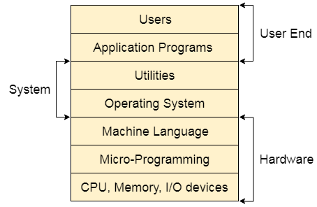
Structure of a Computer System
A Computer System consists of:
Users (people who are using the computer)
Application Programs (Compilers, Databases, Games, Video player, Browsers, etc.)
System Programs (Shells, Editors, Compilers, etc.)
Operating System ( A special program which acts as an interface between user and hardware )
Hardware ( CPU, Disks, Memory, etc.)

Slide 5
What does an Operating system do?
Process Management
Process Synchronization
Memory Management
CPU Scheduling
File Management
Security

Slide 6
Process Management in OS
A Program does nothing unless its instructions are executed by a CPU. A program in execution is called a process. In order to accomplish its task, process needs the computer resources.
There may exist more than one process in the system which may require the same resource at the same time. Therefore, the operating system has to manage all the processes and the resources in a convenient and efficient way.
Some resources may need to be executed by one process at one time to maintain the consistency otherwise the system can become inconsistent and deadlock may occur.

Slide 7
The operating system is responsible for the following activities in connection with Process Management
Scheduling processes and threads on the CPUs.
Creating and deleting both user and system processes.
Suspending and resuming processes.
Providing mechanisms for process synchronization.
Providing mechanisms for process communication.

Slide 8
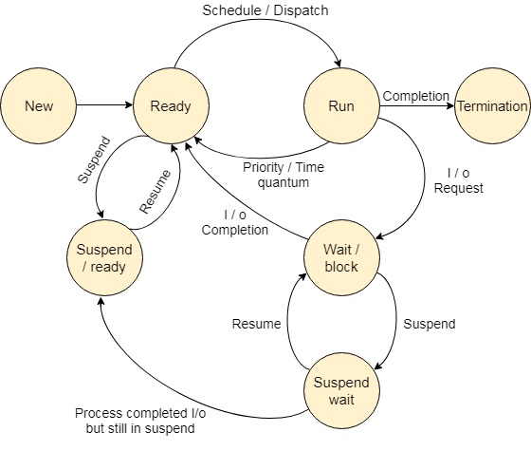
Process States

Slide 9
Process States
The process, from its creation to completion, passes through various states. The minimum number of states is five.
The names of the states are not standardized although the process may be in one of the following states during execution.
New
Ready
Running
Block or wait
Termination or Completion
Suspend Ready
Suspend Wait

Slide 10
1. New
A program which is going to be picked up by the OS into the main memory is called a new process.

Slide 11
2. Ready
Whenever a process is created, it directly enters in the ready state, in which, it waits for the CPU to be assigned. The OS picks the new processes from the secondary memory and put all of them in the main memory.
The processes which are ready for the execution and reside in the main memory are called ready state processes. There can be many processes present in the ready state.

Slide 12
3. Running
One of the processes from the ready state will be chosen by the OS depending upon the scheduling algorithm. Hence, if we have only one CPU in our system, the number of running processes for a particular time will always be one. If we have n processors in the system then we can have n processes running simultaneously.

Slide 13
4. Block or wait
From the Running state, a process can make the transition to the block or wait state depending upon the scheduling algorithm or the intrinsic behavior of the process.
When a process waits for a certain resource to be assigned or for the input from the user then the OS move this process to the block or wait state and assigns the CPU to the other processes.

Slide 14
5. Completion or termination
When a process finishes its execution, it comes in the termination state. All the context of the process (Process Control Block) will also be deleted the process will be terminated by the Operating system.

Slide 15
6. Suspend ready
A process in the ready state, which is moved to secondary memory from the main memory due to lack of the resources (mainly primary memory) is called in the suspend ready state.
If the main memory is full and a higher priority process comes for the execution then the OS have to make the room for the process in the main memory by throwing the lower priority process out into the secondary memory. The suspend ready processes remain in the secondary memory until the main memory gets available.

Slide 16
7. Suspend wait
Instead of removing the process from the ready queue, it's better to remove the blocked process which is waiting for some resources in the main memory. Since it is already waiting for some resource to get available hence it is better if it waits in the secondary memory and make room for the higher priority process. These processes complete their execution once the main memory gets available and their wait is finished.

Slide 17
Operations on the Process
Creation
Scheduling
Execution
Delete and Killing

Slide 18
Process Scheduling in OS
There are three types of OS Schedulers are available to serve the OS
Long-Term Scheduler
Short-Term Scheduler
Medium-Term Scheduler

Slide 19
1. Long term scheduler
Long term scheduler is also known as job scheduler. It chooses the processes from the pool (secondary memory) and keeps them in the ready queue maintained in the primary memory.
Long Term scheduler mainly controls the degree of Multiprogramming. The purpose of long term scheduler is to choose a perfect mix of IO bound and CPU bound processes among the jobs present in the pool.
If the job scheduler chooses more IO bound processes then all of the jobs may reside in the blocked state all the time and the CPU will remain idle most of the time. This will reduce the degree of Multiprogramming. Therefore, the Job of long term scheduler is very critical and may affect the system for a very long time.

Slide 20
2. Short term scheduler
Short term scheduler is also known as CPU scheduler. It selects one of the Jobs from the ready queue and dispatch to the CPU for the execution.
A scheduling algorithm is used to select which job is going to be dispatched for the execution. The Job of the short term scheduler can be very critical in the sense that if it selects job whose CPU burst time is very high then all the jobs after that, will have to wait in the ready queue for a very long time.
This problem is called starvation which may arise if the short term scheduler makes some mistakes while selecting the job.

Slide 21
3. Medium term scheduler
Medium term scheduler takes care of the swapped out processes. If the running state processes needs some IO time for the completion then there is a need to change its state from running to waiting.
Medium term scheduler is used for this purpose. It removes the process from the running state to make room for the other processes. Such processes are the swapped out processes and this procedure is called swapping. The medium term scheduler is responsible for suspending and resuming the processes.
It reduces the degree of multiprogramming. The swapping is necessary to have a perfect mix of processes in the ready queue.

Slide 22
That’s all for today☺ Thank You

